Slide 1


Women Abuse Reporting System

Slide 2
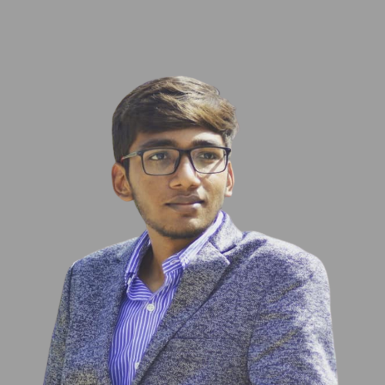
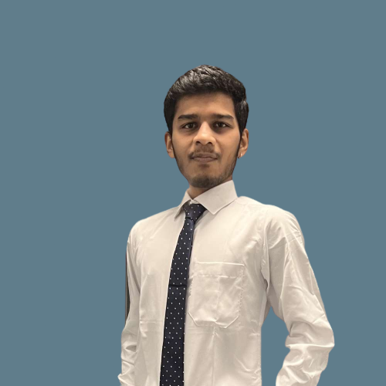

Team
Daksh Patel
Harsh Shah
Moksha Doshi

Slide 3
Problem Statement
Globally, an estimated 736 million women(almost one in three)have been subjected to physical and/or sexual intimate partner violence, non-partner sexual violence, or both at least once in their life.
In 2018, an estimated one in seven women had experienced physical and/or sexual violence from an intimate partner or husband in the past 12 months.
NGOs do not have a centralized system that can help interact with multiple parties to rescue and rehabilitate women who are victims of multiple atrocities.

Slide 4




Design a software system for NGOs that can initiate a restoration process for a woman who has been a victim of atrocities through reporting to an NGO
Software
Our
Approach
Volunteer from NGO would be assigned to the case, he would then examine the case and redirect the case to the necessary stakeholder.
NGO
Women who faced physical abuse would be sent to doctors, mental abuse would be sent to a counselor or psychiatrist depending on their state of need. In case of any unlawful situation, the case can be sent to a lawyer.
Action

Slide 5
Ecosystem
Roles
Work
Request
Network
Object Model
UserAccount
Work
Queue
Enterprise directory
Enterprise
Organization directory
Organization
UserAccount Directory

Slide 6




Enterprises
JUSTICE
WELLNESS
NGO
PHARMACY

Slide 7









Roles
Victim
Reporter
Volunteer
Counselor
Lawyer
Doctor
Lab Assistant
Pharmacist
Psychiatrist
System Admin

Slide 8
WELLNESS
PHARMACY
NGO
JUSTICE

Slide 9
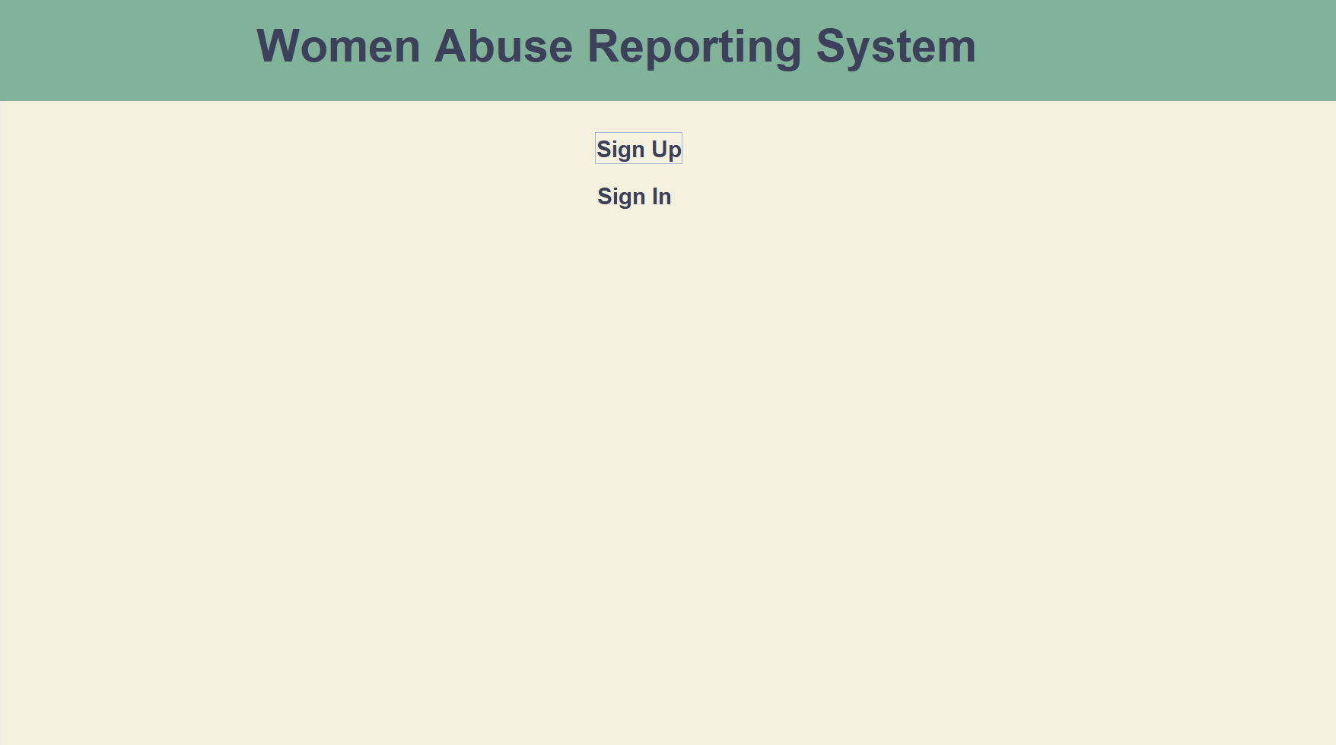
DASHBOARD

Slide 10
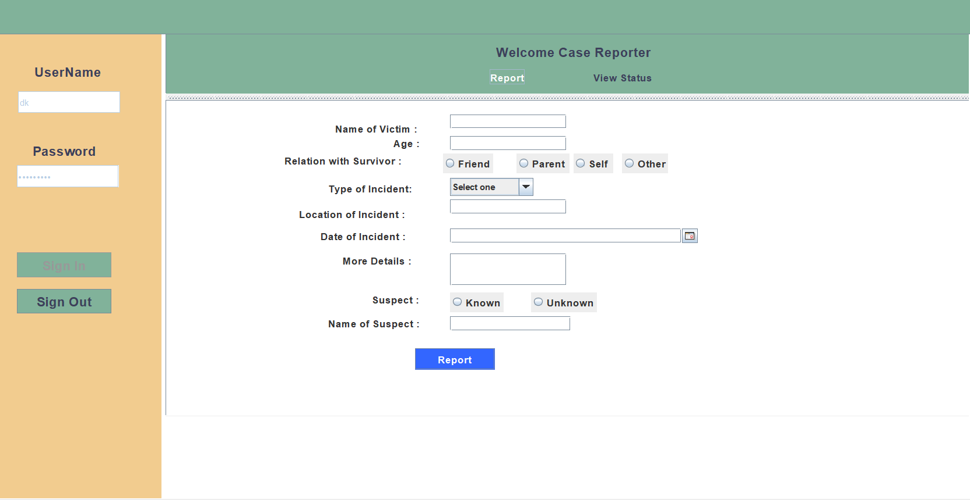
CASE REPORTER PAGE

Slide 11
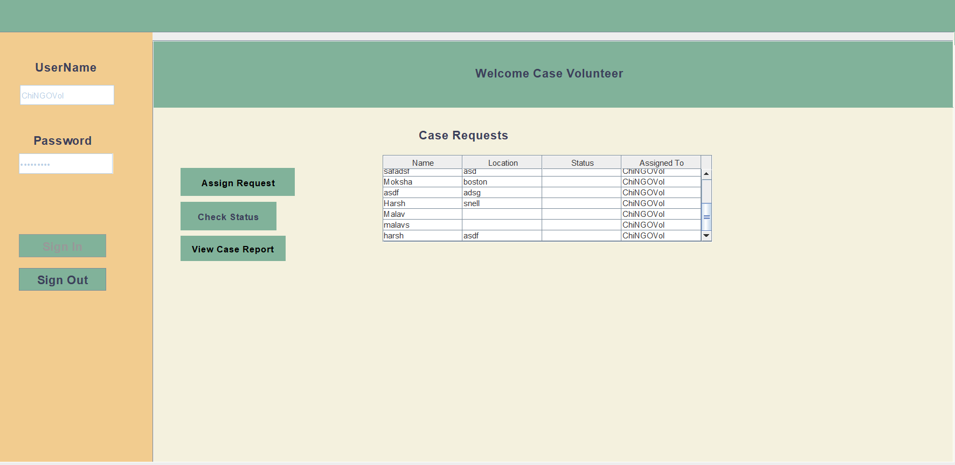
CASE VOLUNTEER PAGE

Slide 12
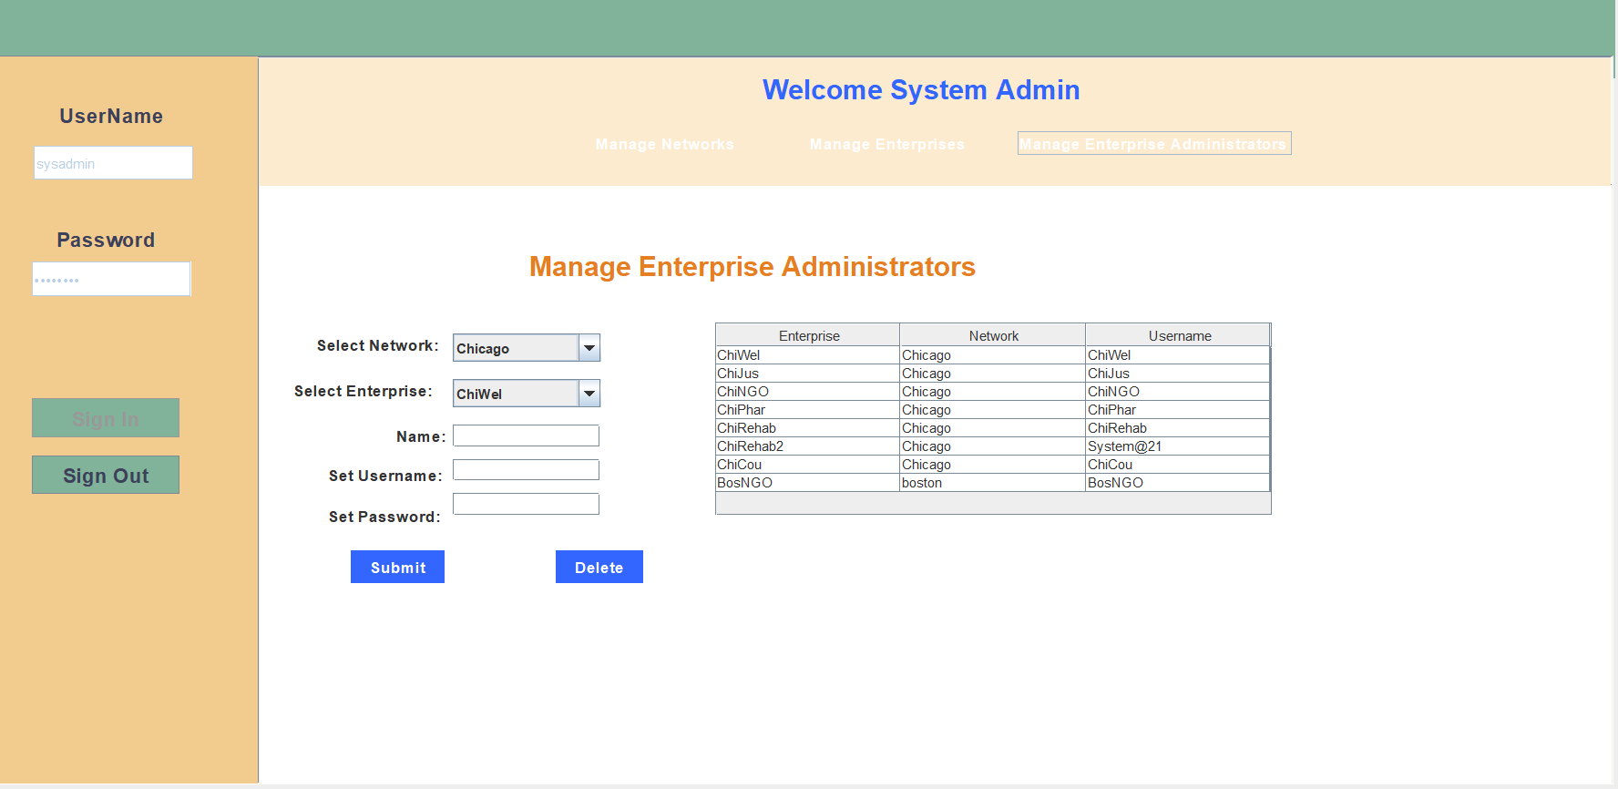
SYSTEM ADMIN

Slide 13
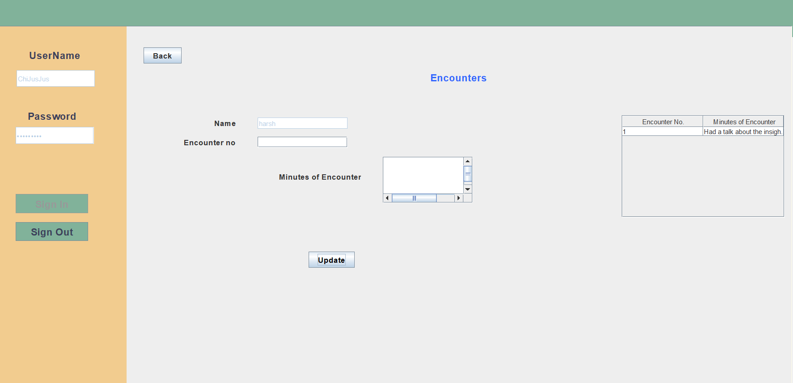
CASE ENCOUNTER DETAILS

Slide 14
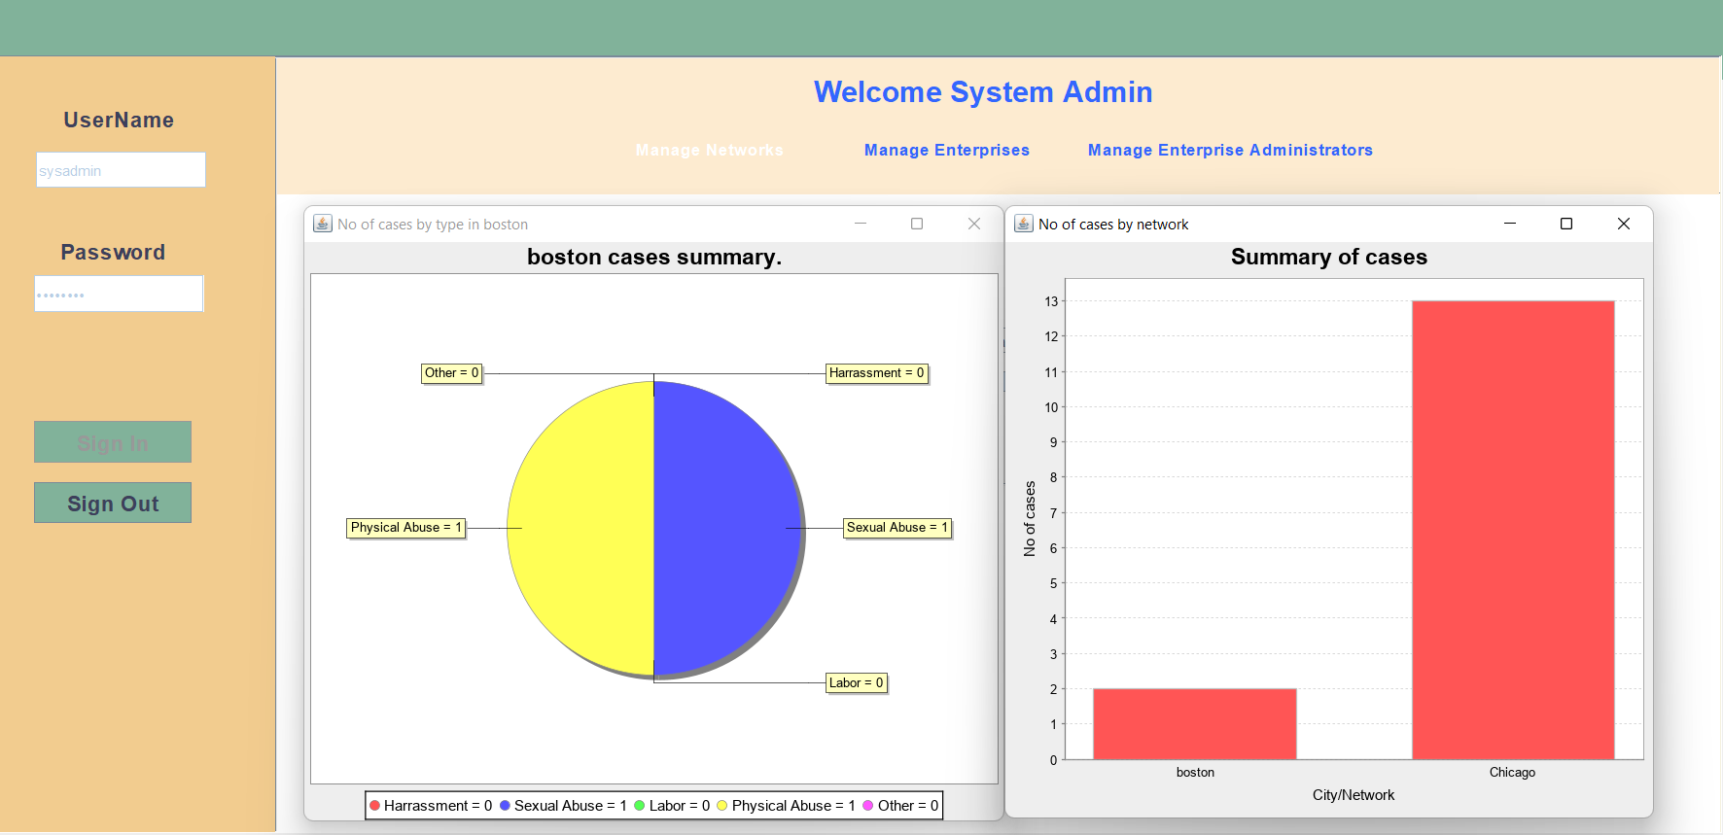
TOTAL CASE STATISTICS

Slide 15


Learning Outcomes
Time Completion Strategies, Analysis, and estimation for each task
Designing and Developing the Complex model
Integration of the database to the Java Application
Implementations of Advance java Concepts
Planning and Collaboration for parallel work in
Team(GitHub)
Customer and Business requirement gathering

Slide 16
THANK YOU

